Slide 1

Some of my new favourite things for working with R
Jovana Maksimovic
RLadies Melbourne February 20th 2017

Slide 2
Outline
A little bit about me
An example of one type of data I work with
DNA methylation
The way I used to do things
Rmarkdown + Git + Github
The way I do things now
R Notebooks + Git + Github
Why not Jupyter/IPython?
Making “aheatmap” with waaaaay less code
The NMF package

Slide 3
A bit about me
Bioinformatician at MCRI
Analyse large datasets to answer biological questions
Usually, I work with DNA, RNA, methylation data
Mostly use R (RStudio)
Bioconductor, CRAN, GitHub
Also use bash, python, groovy, Java, or whatever else, when I need to…

Slide 4
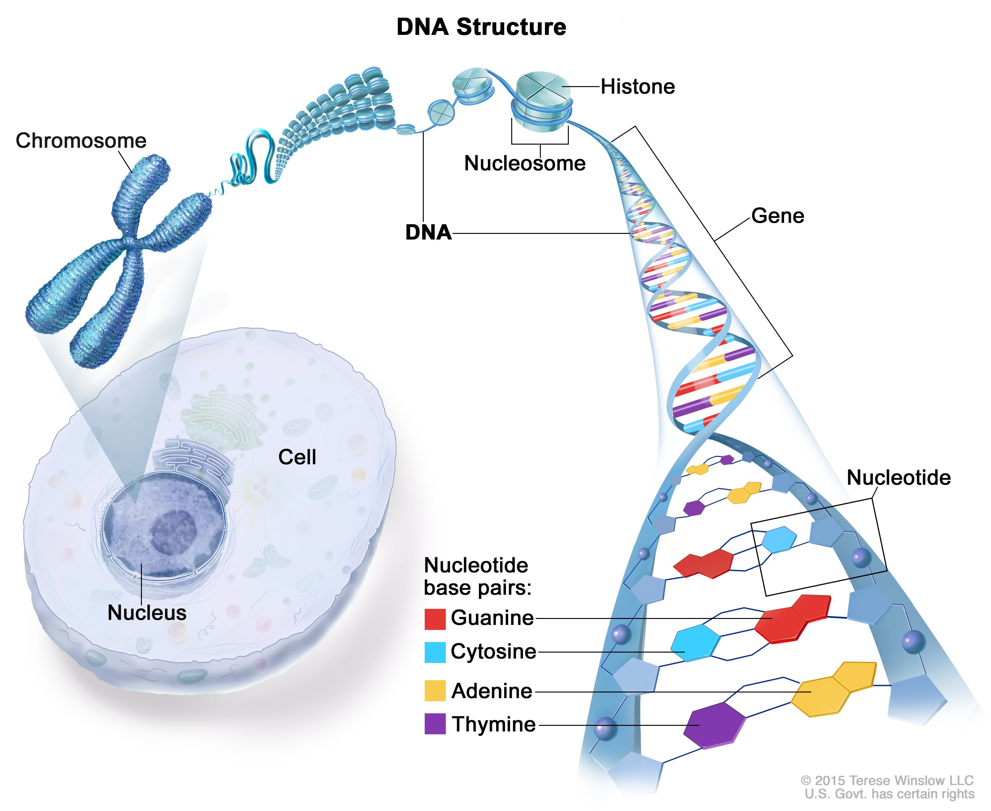
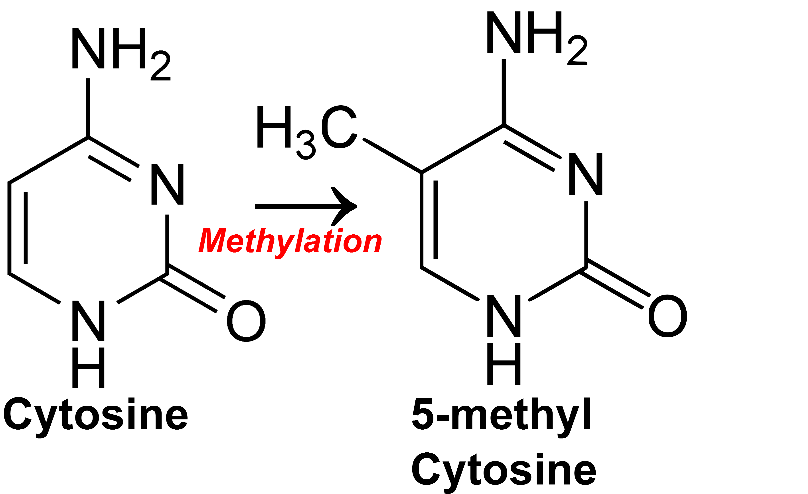
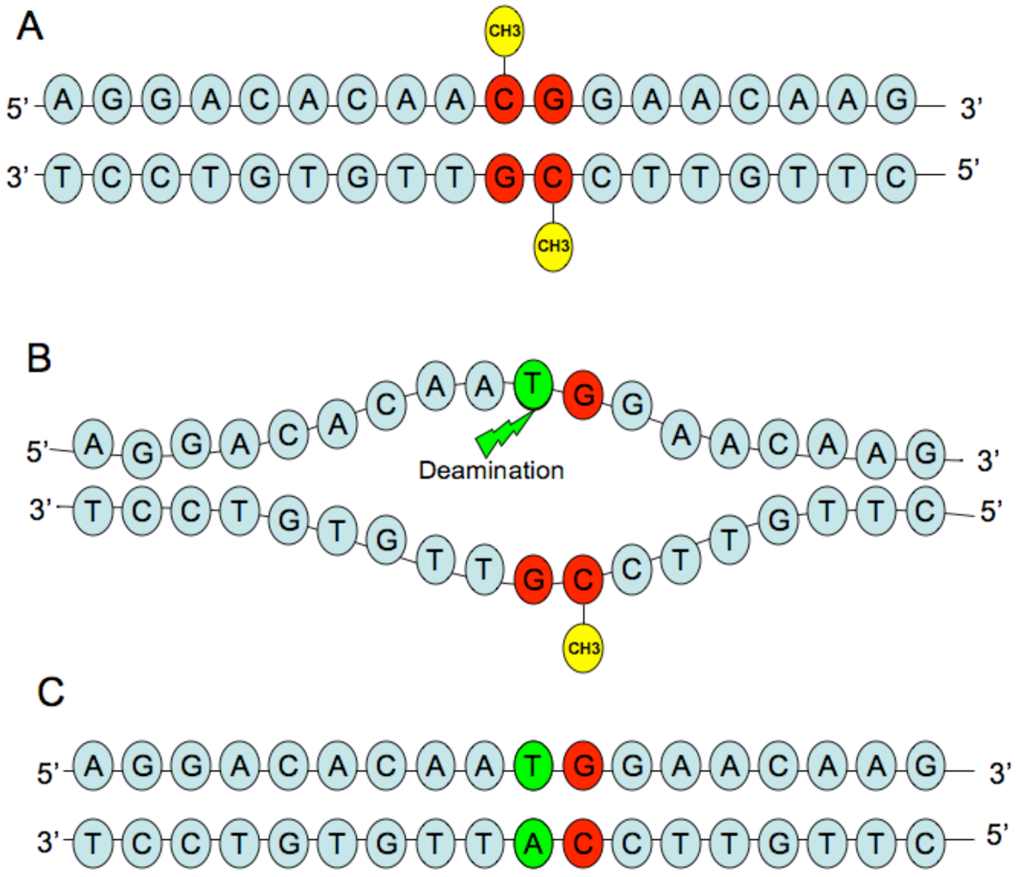
What is DNA methylation?
C
C
C
G
A
T
DNA methylation primarily occurs at CpG dinucleotides
Notes:
Our bodies are made up of billions of cells.
Each cell has a copy of our DNA that is packaged into chromosomes.
The DNA encodes our genes using the 4 bases, A, T, C and G.
The C or cytosine base of the DNA can be chemically modified by the editions of a methyl group so that it becomes “methylated”.
DNA methylation primarily occurs at CpG dinucleotides in the genome.

Slide 5


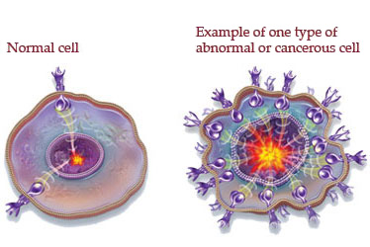
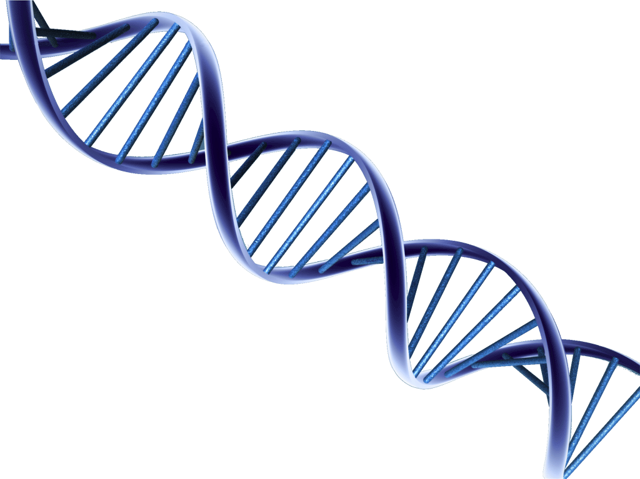
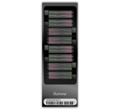


We are usually interested in finding methylation differences
Methylation is critical in determining cell type
Regulatory T-cell vs. Naïve T-cell
Methylation can be disrupted in disease
Cancer vs. Normal
Methylation is affected by the environment
Smoking vs. Non-smoking
Collect appropriate samples
Extract DNA and measure methylation
Statistical analysis
Normal
Cancer
Notes:
When we study methylation, we are usually interested in finding methylation differences.
Because methylation is critical in determining cell types, we often want to know what the differences between cell types are.
Methylation can also be disrupted in disease, for example cancer.
So, we may want to compare cancer and normal tissue.
Methylation has also been shown to be affected by environmental factor such as smoking.
So, we may want to compare smokers and non smokers.
In a typical methylation study, we firstly collect the appropriate samples, for example normal and cancer cells.
Then we extract their DNA and measure the methylation using microarrays.
Once we have the data we can then do statistical analysis using various Bioconductor packages.

Slide 6
Methylation data is high-dimensional: “large p small n”
Samples (n)
CpGs
(p)
Feature | Normal_R01C02 | Normal_R02C01 | Normal_R02C02 | Normal_R03C01 | Normal_R03C02
cg00000957 | 1.18641319 | 1.6833918 | 1.4954961 | 1.2744786 | 1.6690126
cg00001349 | 2.78175163 | 2.9826377 | 2.2099616 | 2.4037474 | 2.6816914
cg00001583 | -3.88278946 | -3.9381707 | -3.5134463 | -3.6899728 | -3.455176
cg00002028 | -4.05599904 | -4.7481041 | -3.7305472 | -4.3272016 | -4.8648515
cg00002719 | -3.76483514 | -3.4216002 | -3.9439967 | -4.0046091 | -3.8363634
cg00002837 | -0.74721329 | -0.6105303 | -0.3634655 | -0.2133664 | -0.551842
cg00003287 | -1.64213183 | -1.5900839 | -1.7388589 | -1.3755244 | -1.3879943
cg00004121 | -0.01867237 | 0.3593965 | 0.2780545 | 0.9362344 | 0.668965
cg00007036 | 5.59249849 | 4.8156606 | 4.4512538 | 4.5920039 | 5.7490799
cg00007898 | -3.88251448 | -4.5050239 | -4.1450495 | -4.1430441 | -3.9495167
cg00008647 | -3.07921933 | -3.5629083 | -3.3527079 | -3.0239399 | -2.7583516
cg00009916 | -5.29768055 | -4.7584404 | -4.674853 | -4.5345207 | -4.5351973
cg00011717 | 5.09126921 | 4.7522202 | 4.8062095 | 4.6035337 | 4.9812939
… more columns (1 for each sample)
…
445,370 more rows (450k array) (1 for each CpG)
Modified slide from Belinda Phipson
Notes:
So, what does the data actually look like?
Methylation data is high dimensional. It is essentially a large matrix of M or beta values with n samples and p CpGs – of which there will be several 100 thousand depending on which array was used.
We generally do statistical testing on M values as they better satisfy the assumptions of the test used.
They have been show to be approximately homoscedastic and they are more normally distributed across samples for each CpG.
We do one statistical test for each CpG – we won’t build giant models to combine them.

Slide 7



One of my projects
Cord blood samples from 10 individuals
FA
FA
FA
FA
FA
Non
Non
Non
Non
Non
Food allergy phenotype
4 cell types
rTreg
Mono
CD4
CD8
9 conditions (CD4/CD8)
None
aCD3.CD28alone
IL2
IL2.IL12
IL2.IL4
IL2.TGFb
IL6.TGFb
IL1b.TGFb
TNFa.TGFb
None
aCD3.CD28alone
IL2
IL2.IL12
IL2.IL4
IL2.TGFb
IL6.TGFb
IL1b.TGFb
TNFa.TGFb
195 samples
Notes:
The dataset I’ll be talking about the analysis of is a large and complex dataset from an ongoing collaboration.
It contains methylation data from 10 individuals, 8 of whom were female and 2 males. There is also a food allergy phenotype, 5 of the individuals were food allergic and 5 were not.
Allergy is a very small factor in this dataset and I won’t be discussing it today.
The 10 cord blood samples were sorted into 4 cell types; regulatory t cells, monocytes, CD4 cells and CD8 cells.
The CD4 and CD8 cells were then exposed to 9 different conditions, which cause the cells to differentiate into different lineages.
I’ll be focusing on the CD4 and CD8 differentiation samples in this talk.
With all of these different cell types and conditions and some missing samples we have 195 samples in total.

Slide 8
So, the data looks a bit like this…
Samples (195)
CpGs
(>450k)
Feature | Normal_R01C02 | Normal_R02C01 | Normal_R02C02 | Normal_R03C01 | Normal_R03C02
cg00000957 | 1.18641319 | 1.6833918 | 1.4954961 | 1.2744786 | 1.6690126
cg00001349 | 2.78175163 | 2.9826377 | 2.2099616 | 2.4037474 | 2.6816914
cg00001583 | -3.88278946 | -3.9381707 | -3.5134463 | -3.6899728 | -3.455176
cg00002028 | -4.05599904 | -4.7481041 | -3.7305472 | -4.3272016 | -4.8648515
cg00002719 | -3.76483514 | -3.4216002 | -3.9439967 | -4.0046091 | -3.8363634
cg00002837 | -0.74721329 | -0.6105303 | -0.3634655 | -0.2133664 | -0.551842
cg00003287 | -1.64213183 | -1.5900839 | -1.7388589 | -1.3755244 | -1.3879943
cg00004121 | -0.01867237 | 0.3593965 | 0.2780545 | 0.9362344 | 0.668965
cg00007036 | 5.59249849 | 4.8156606 | 4.4512538 | 4.5920039 | 5.7490799
cg00007898 | -3.88251448 | -4.5050239 | -4.1450495 | -4.1430441 | -3.9495167
cg00008647 | -3.07921933 | -3.5629083 | -3.3527079 | -3.0239399 | -2.7583516
cg00009916 | -5.29768055 | -4.7584404 | -4.674853 | -4.5345207 | -4.5351973
cg00011717 | 5.09126921 | 4.7522202 | 4.8062095 | 4.6035337 | 4.9812939
… more columns (1 for each sample)
…
>450,000 more rows (450k array) (1 for each CpG)
Modified slide from Belinda Phipson
Notes:
So, what does the data actually look like?
Methylation data is high dimensional. It is essentially a large matrix of M or beta values with n samples and p CpGs – of which there will be several 100 thousand depending on which array was used.
We generally do statistical testing on M values as they better satisfy the assumptions of the test used.
They have been show to be approximately homoscedastic and they are more normally distributed across samples for each CpG.
We do one statistical test for each CpG – we won’t build giant models to combine them.

Slide 9
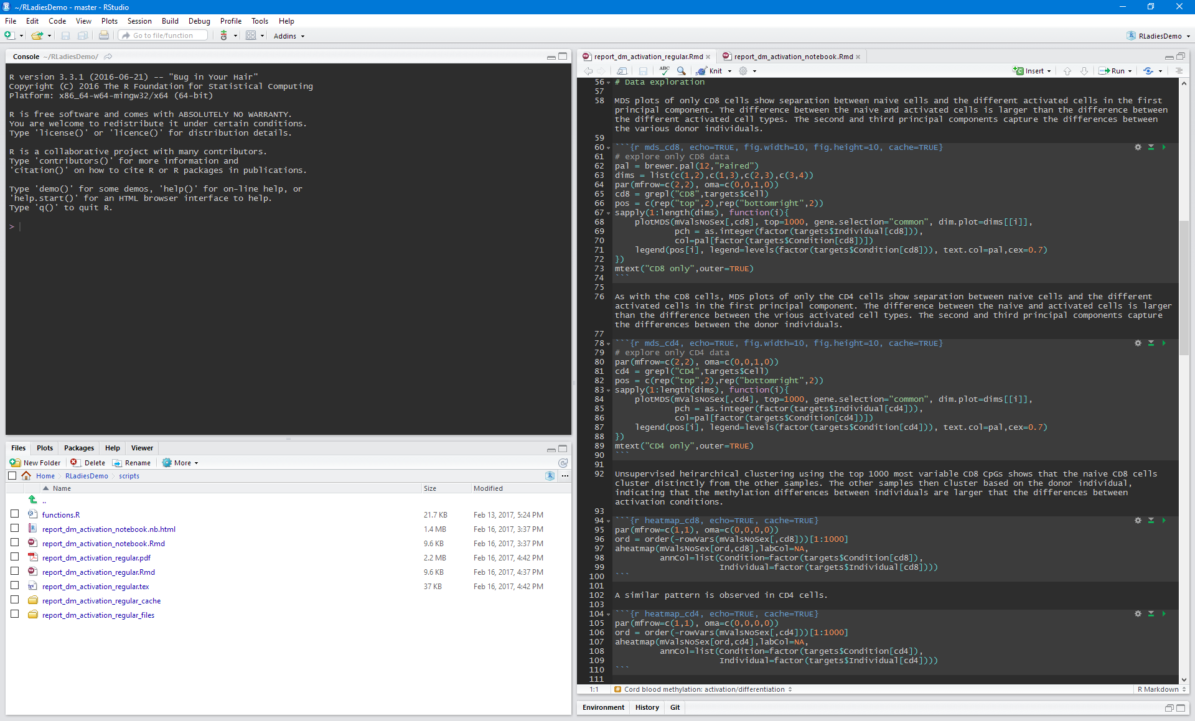
Rstudio + Rmarkdown + Git

Slide 10
Many pros, but also cons
R Markdown makes it easy to prepare reports and annotate/explain analysis steps
Just text, so easy version control with Git/Github
Can render pdf/html/doc report files
Include all figures
Show/hide code
With large data, reports can take a long time to render
Annoying when making small changes
Output & figures are disconnected from code chunks
Either preview in console/window or save to file
For this very large project, things started getting a bit CRAZY!

Slide 11
R Notebooks
Available in RStudio 1.0.0+
Based on R Markdown plain-text tools
Unlike regular R Markdown, R Notebooks let you run code and see the results in the document immediately
R Notebooks can run more than just R code
You can run chunks written in Python, Bash, or C++ (Rcpp)
As well as single line execution, can easily re-execute all code from start-to-finish in a clean environment
R Notebooks work with other R Markdown output types
Can use any existing R Markdown document as a notebook
Can render (knit) a notebook to any R Markdown output type
Easy to share with collaborators
Because they’re plain-text files, work well with version control systems like Git
Don’t need RStudio to edit => can be rendered in R console using the open source rmarkdown package

Slide 12
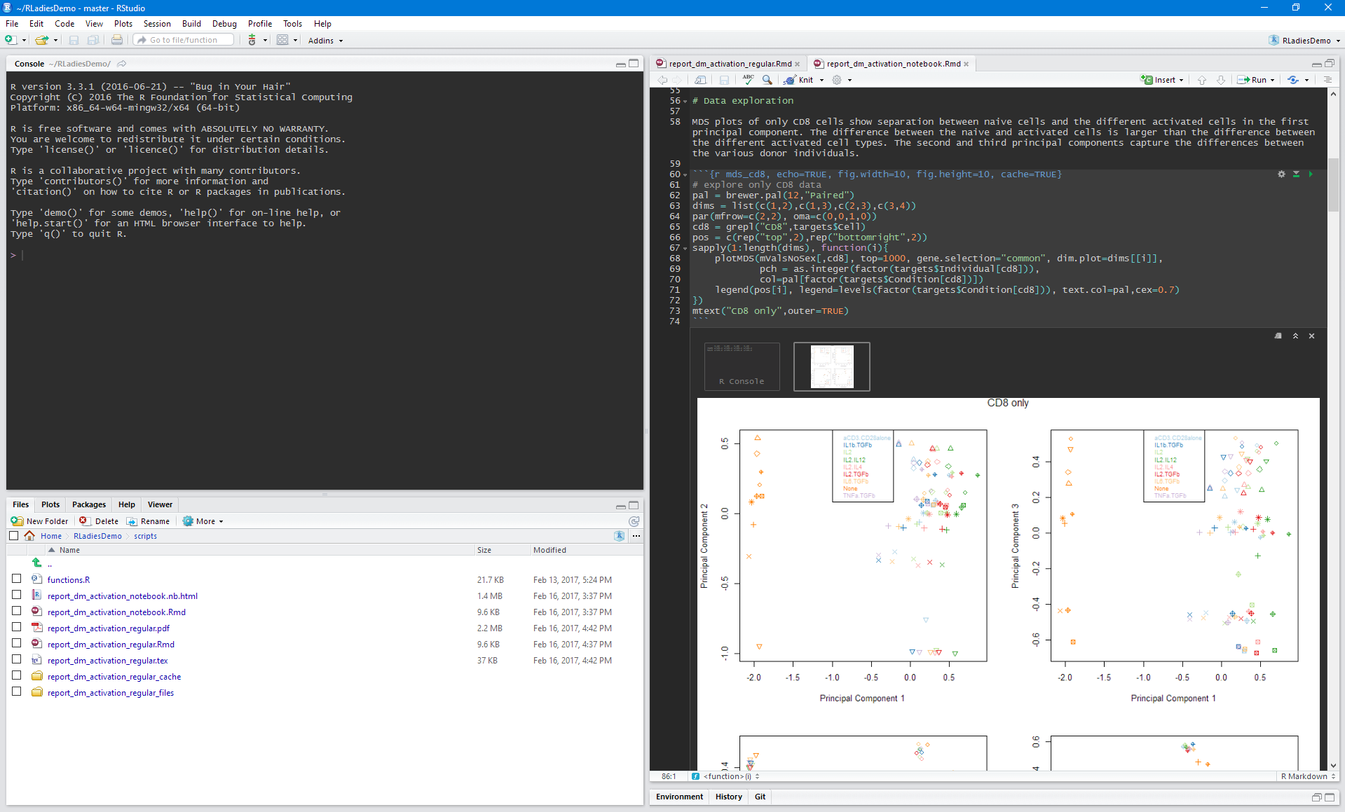
Rstudio + R Notebooks + Git

Slide 13
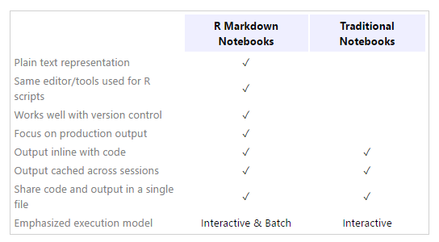
Why not Jupyter/IPython?
Not great with version control
Can only run code in chunks
Code can end up fragmented
Output can be incomplete

Slide 14
CRAN NMF: aheatmap
aheatmap is a function for plotting heatmaps
Detailed legend
Unlimited annotation tracks for both columns and rows
Annotations are coloured differently according to their type (factor or numeric covariate)
Automatically chooses nice colours using RColorBrewer or ggplot colour palettes
Uses grid graphics BUT compatible with base layouts
e.g. “mfrow” or “layout”, enabling the easy drawing of multiple heatmaps on a single a plot

Slide 15
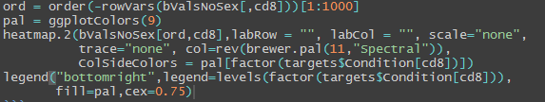
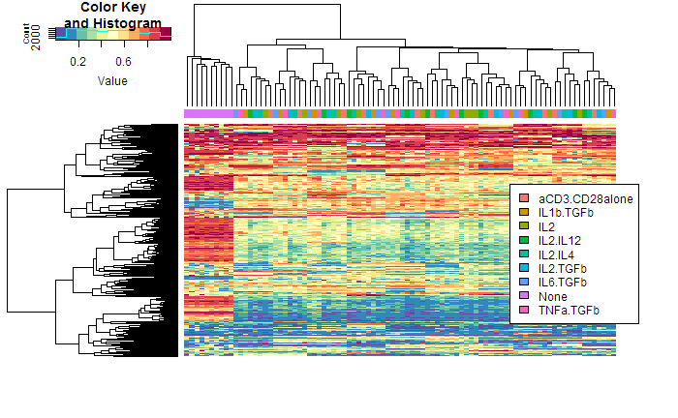
My heatmap life before

Slide 16

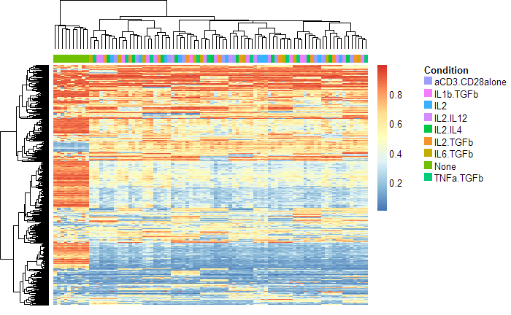
My heatmap life now

Slide 17
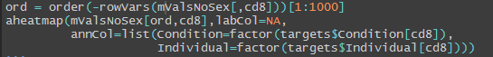
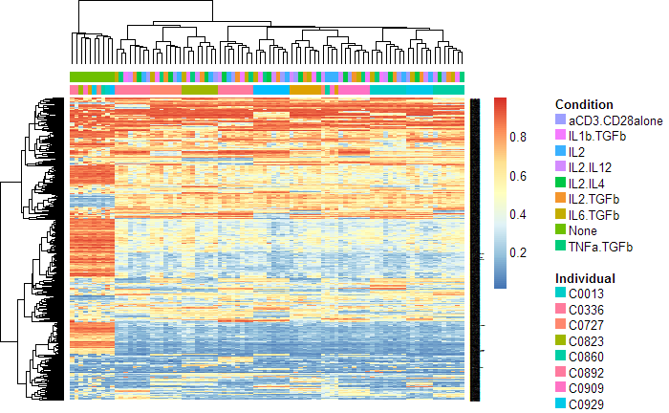
Adding extra annotation tracks

Slide 18
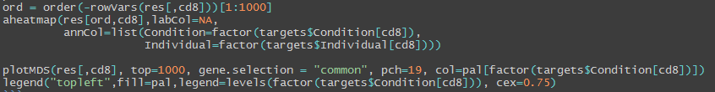
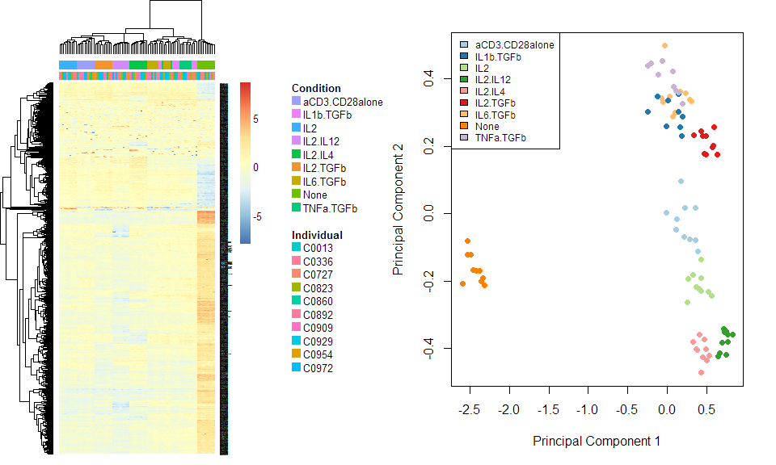
Multiple heatmaps

Slide 19
More info
Download Rstudio
https://www.rstudio.com/
RStudio blog about R Notebooks
https://blog.rstudio.org/2016/10/05/r-notebooks/
http://rmarkdown.rstudio.com/r_notebooks.html
CRAN NMF package (aheatmap)
https://cran.r-project.org/web/packages/NMF/index.html
install.packages(“NMF”)

Slide 20


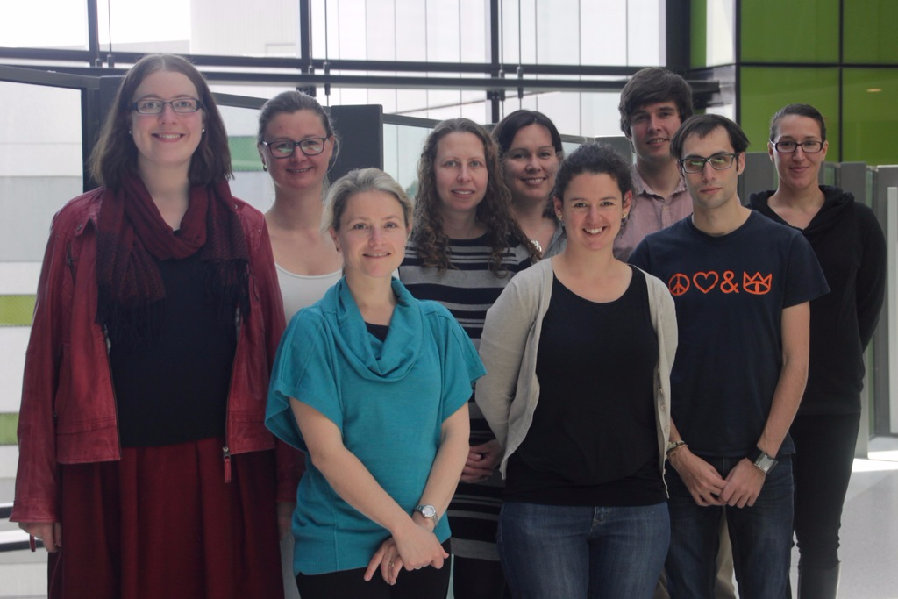

Thanks ☺
@JovMaksimovic
https://github.com/JovMaksimovic
https://bioconductor.org/packages/ release/bioc/html/missMethyl.html
source("https://bioconductor.org/biocLite.R") biocLite("missMethyl")
MCRI Bioinformatics Group
http://oshlacklab.com/
https://github.com/Oshlack

